Slide 1


Victor Matos

Slide 2
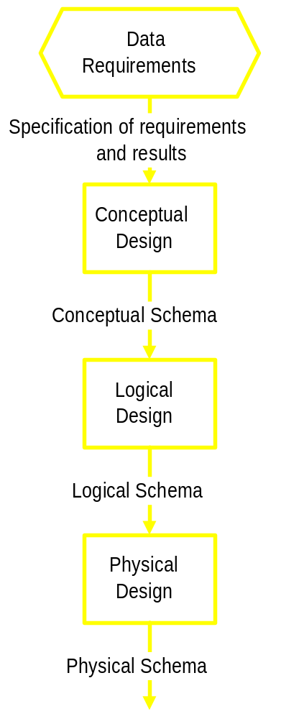
Phases of Database Design
Conceptual design begins with the collection of requirements and results needed from the database (ER Diag.)
Logical schema is a description of the structure of the database (Relational, Network, etc.)
Physical schema is a description of the implementation (programs, tables, dictionaries, catalogs

Slide 3

A data model is a collection of objects that can be used to represent a set of data and operations to manipulate the data
Conceptual models are tools for representing reality at a very high-level of abstraction
Logical models are data descriptions that can be processed by computers

Slide 4

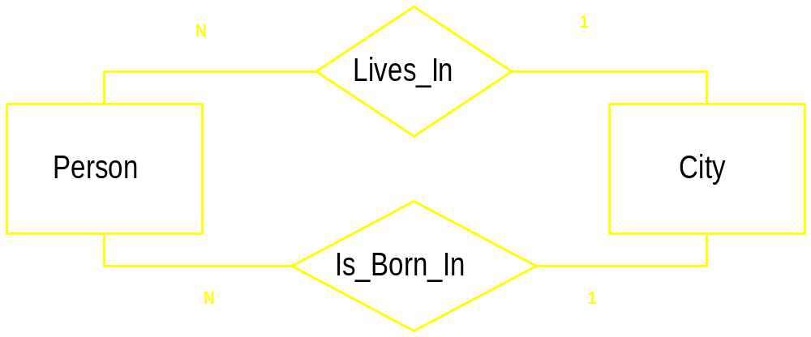
Entities represent classes of real-world objects. Person, Students, Projects, Courses are entities of a University database
Relationships represent interactions between two or more entities

Slide 5

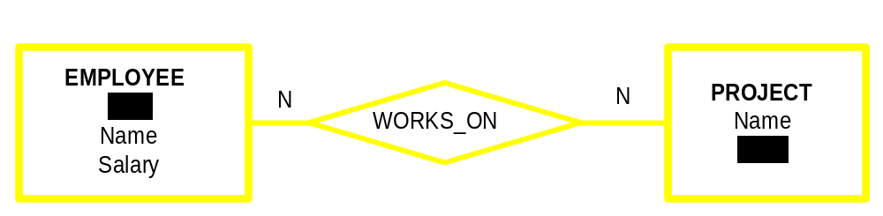
Every employee works in at least one project
Every project has employees working on it.

Slide 6

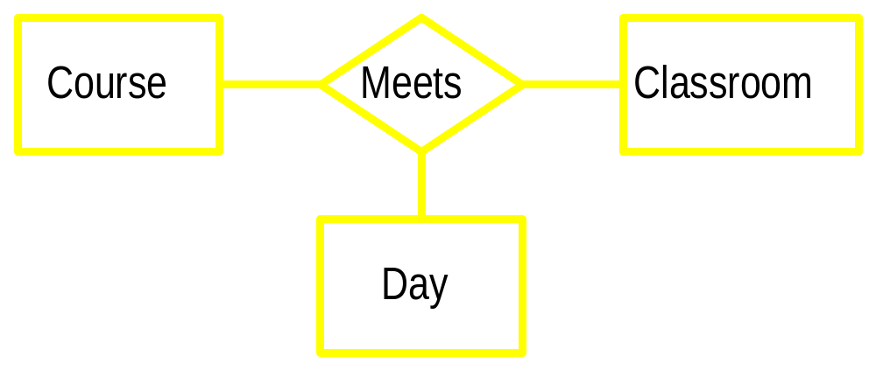
A relationship may involve more than two entities

Slide 7

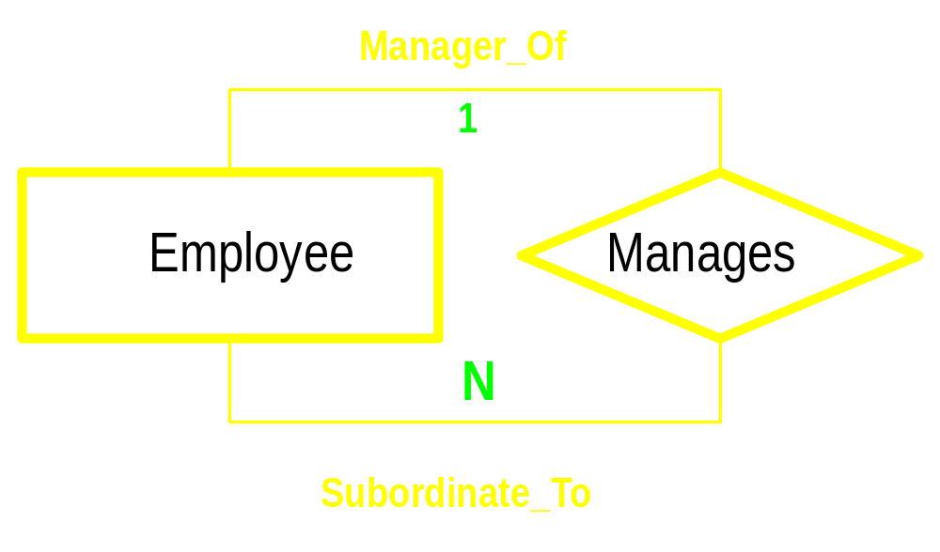
Relationships could be mapped from one entity to itself

Slide 8

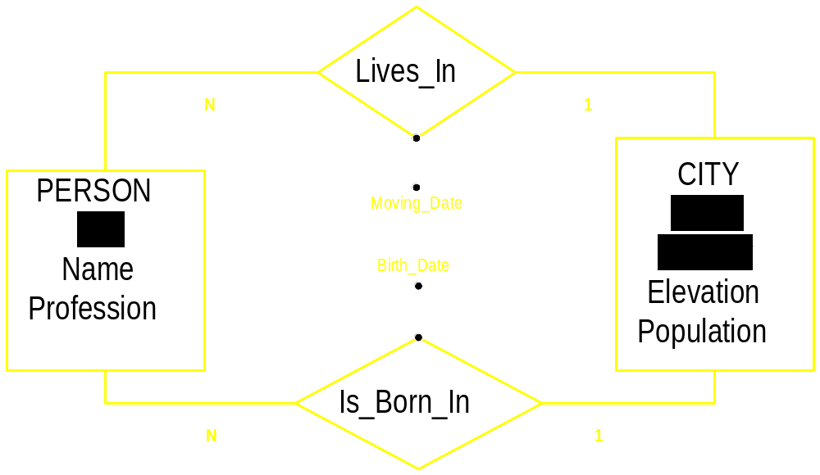
Attributes represent elementary properties of the entities or relationships. The stored data will be kept as values of the attributes

Slide 9

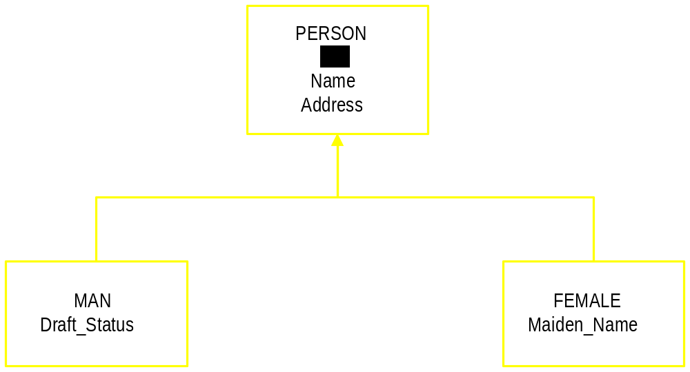
An entity could be seen from many different viewpoints
Each viewpoint defines a set of roles in a generalization
Example below uses SEX to classify the object “Person”

Slide 10
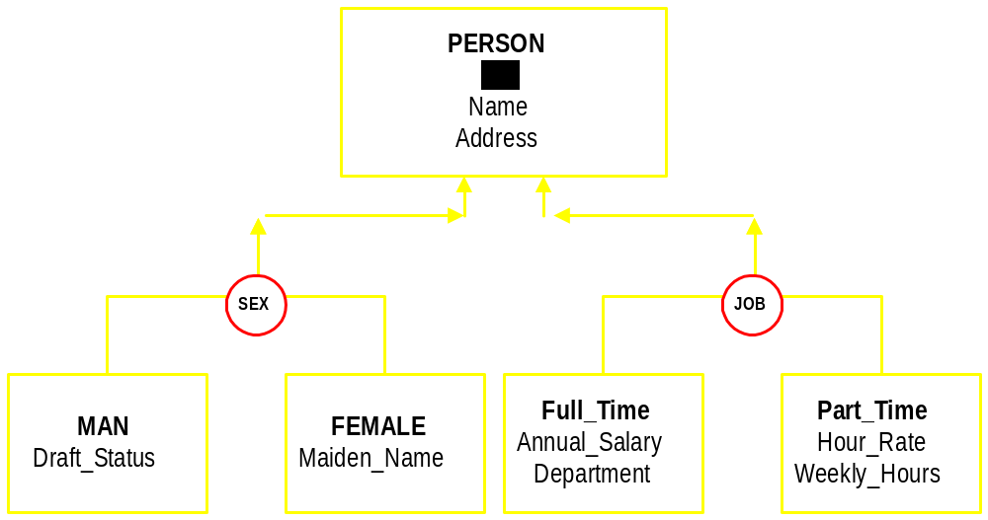
A classification could be disjoint or overlapping
An entity could have more than one classification

Slide 11

A department store operates in several cities
In a city there is one headquarter coordinating the local operations
A city may have several stores
Stores hold any amount of items
Customers place their orders for any number of items to a given store
GOAL: Optimize shopping in each city

Slide 12

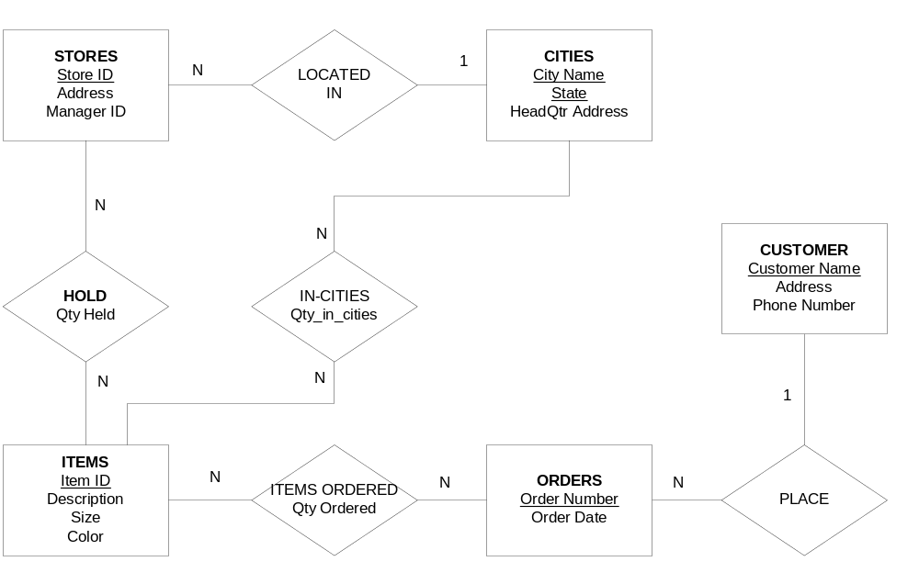

Slide 13

Professors work for only one department
Departments have many professors
Each course is taught by only one professor
Students make a plan or program of study
A course could meet in several rooms/times
Graduate students must have an advisor
Cities are categorized as resident/BirthPlace
Visiting prof. need an End/Start date

Slide 14

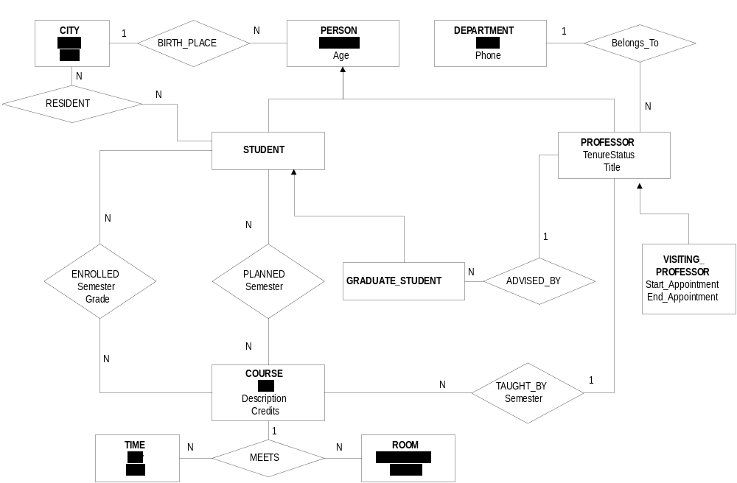
University database

Slide 15

A team has players, one coach, fans
Teams play according to a schedule
Teams need to practice in a Stadium
Attendance and scores must be recorded

Slide 16
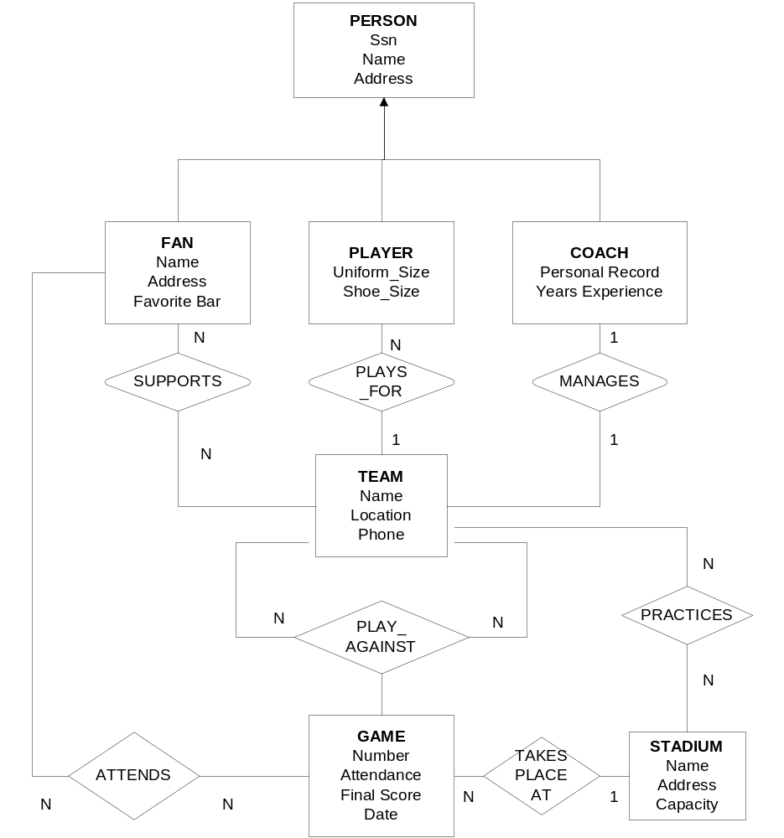

Slide 17

Some employees are researchers
Every project has a leader investigator
Every project must be funded by an agency
A project may include several topics
A topic could appear in several projects
Researchers must produce report(s)
Each employee must have a supervisor

Slide 18

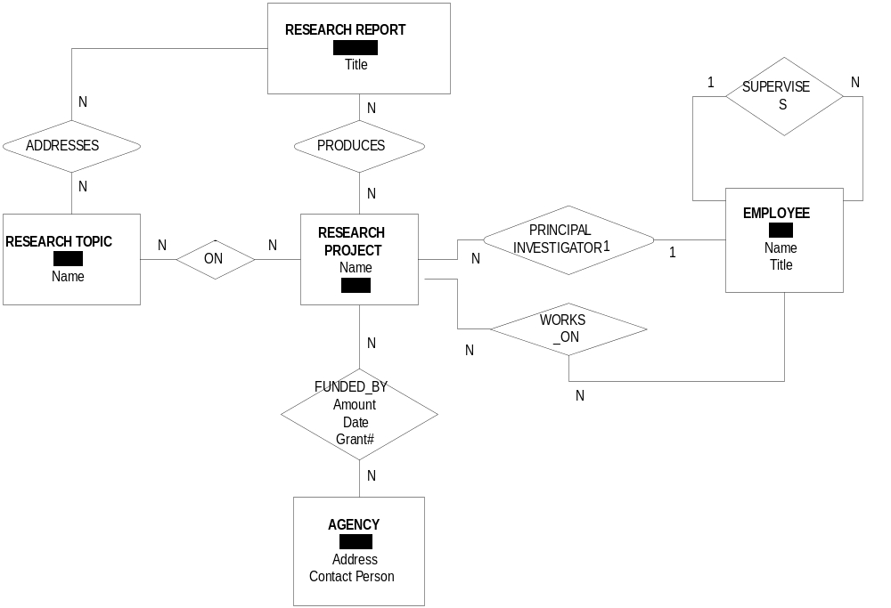

Slide 19

A company negotiates contracts with suppliers to provide certain amount of items at a fixed price
Orders are placed against any of the already negotiated contracts
A contract could provide items to any number of orders

Slide 20

An order may include any number of items negotiated in the contract
Orders should not exceed the maximum amount of items quoted in the contract
All items in an order must be provided as part of a single contract and a single project

Slide 21

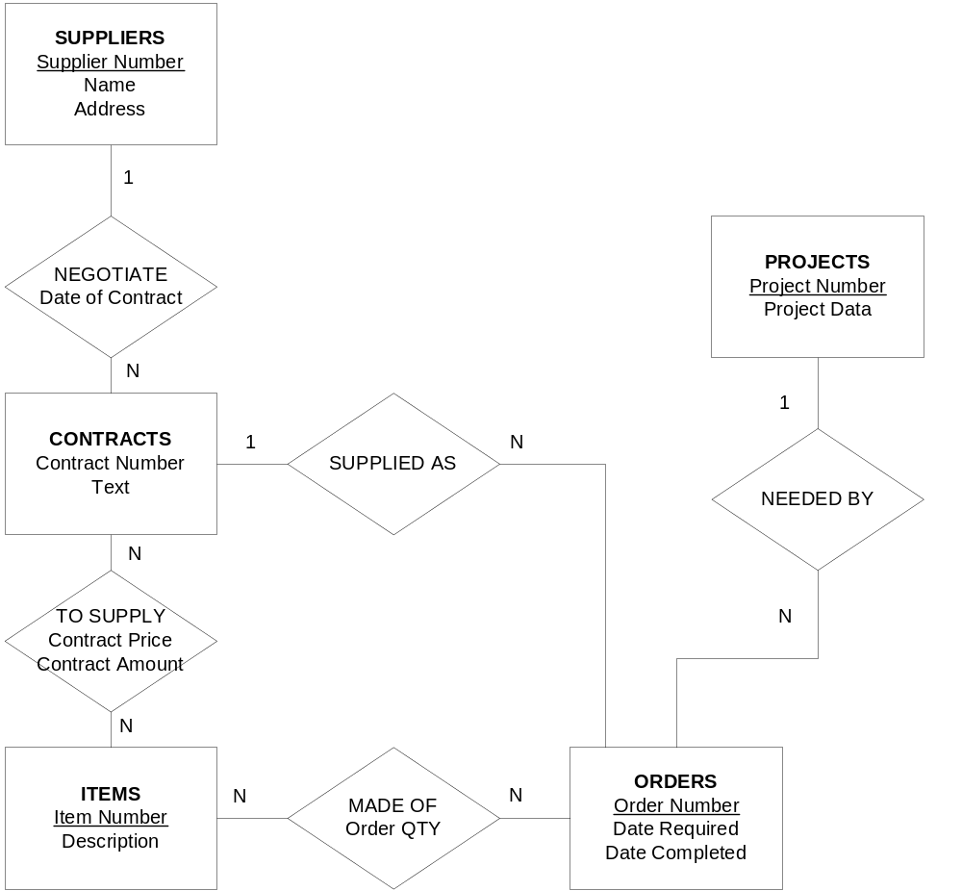

Slide 22

Projects are broken into tasks
Tasks are assigned to departments
A task is created for one project and assigned to one department
Requisitions are made for projects
Each requisition could ask for any number of items

Slide 23

Each requisition is for one project and is made to one supplier
Items could be: equipment or materials and are coded in a similar way
Suppliers send periodic price notices to advise the company of any changes in their prices

Slide 24

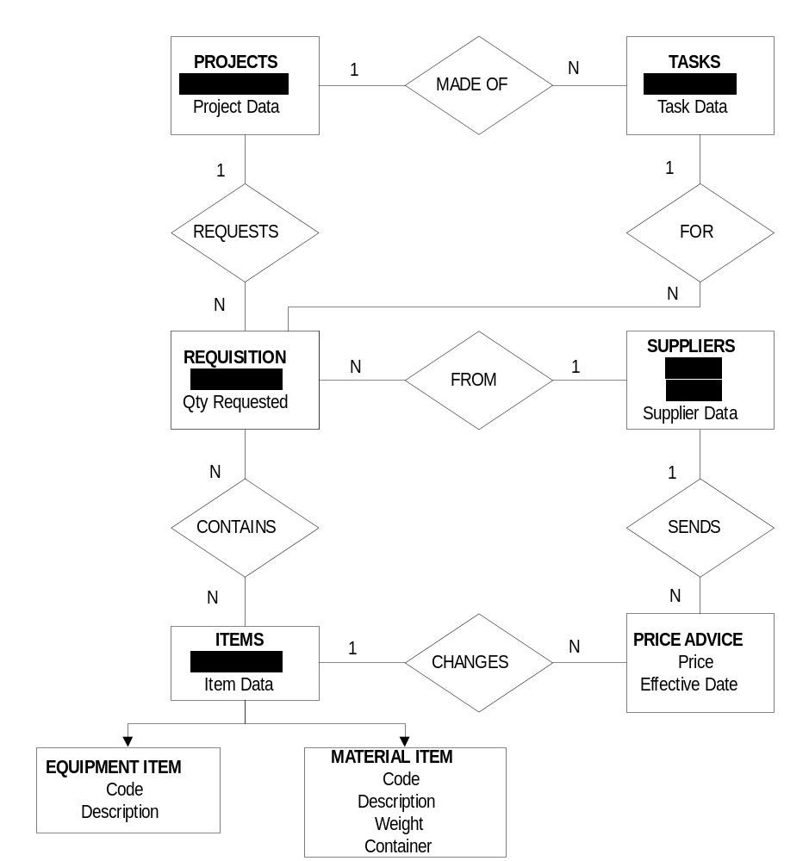

Slide 25

The system is used by a company that manufactures special-purpose assemblies for customers
To manufacture assemblies the company creates a sequence of processes (steps)
Each process is supervised by a department
Assume there are three type of processes: PAINT, FIT, CUT

Slide 26

During manufacturing an assembly could pass through any sequence of processes, in any order; it may pass through the same process more than once
A unique Job# is given to any new assembly.
Costs and started-terminated dates must be recorded

Slide 27

An accounting system is used to keep track expenditure for each:
      DEPT,
      PROCESS,
      ASSEMBLY
As a job proceeds, cost transactions can be recorded against it.

Slide 28

